Slide 1
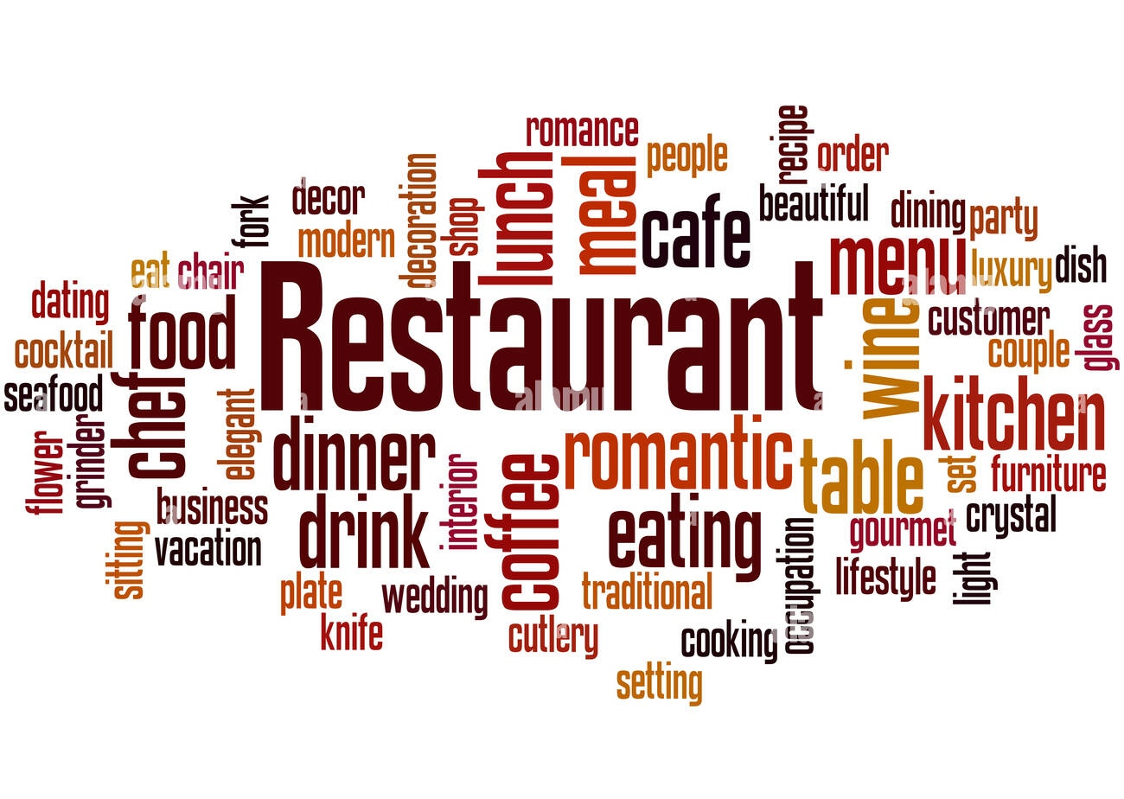

Slide 2
PROJECT TITLE
#Restaurant
# Team members #
Names Roll no Github link
Akanksha chaudhari 29 https://github.com/akankshachaudhari04/Restuarant.git
Lina khadke 69 https://github.com/LinaKhadke2001/Resturant.git
Madhavi koshti 76. https://github.com/MadhaviKoshti1127/Resturant.git
Swati pArdeshi 118 https://github.com/PardeshiSwati/Project.git
Vaishnavi sonawane 185 https://github.com/VaishnaviIMR/Resturant.git
Vrushali patil 154 https://github.com/Vrushalipatil2001/Resturant.git

Slide 3
INTRODUCTION
A restaurant is a fantastic opportunity for investment business. The purpose of restaurant is people enjoy their holiday, celebrate their birthday party, wedding party, and other. A Place to relax and enjoy the company of family and friend. Many employee and student does not have time to cooks at home, they need to eat from restaurant so they can power to go there job or classes or if you are hunger to can go there and have your favorite meal. In our Restaurant many Facilities or services are available. In our restaurant Booking tables or Booking restaurant for any function are available.

Slide 4
PROJECT FEATURES
Objectives:
A project has a predetermined set of goals.Once the objectives have been achieved, the project ceases to exist.
Uniqueness:
No two projects are exactly similar even if Die plants are exactly identical or are merely duplicated. The location, the infrastructure, the agencies, and the people make each project unique.
Change:
A project sees many changes throughout its life while some of these changes may not have any major impact; they can be some changes which will change the entire character of course of the project.
Built to order:
Every project is created according to the client's instructions. Numerous rules and restrictions set forth by the client must be followed in order for the project to be completed.

Slide 5
System Facilities
The Proposed system fulfills all the functions needed by the
management regarding database entries, customer and
payment details.
• System maintains all required information of the customer,
vendor, purchase payment details, sales details.
• System maintains backup of database , import data, export
data to avoid loss of data.
• The System allows the user to calculate any sort of
payment related calculations.
• Bills are also generated automatically.
• System maintains details of the stock.

Slide 6
Software Requirement
Software Requirement as follows:
Technologies : HTML ,CSS , Bootstrap, JavaScript.
Database: MySQL.
Language: Web programming.
IDE: Notepad++ , Visual studio.

Slide 7
Hardware requirements
The most common set of requirements defined by any operating system or software application is the physical computer resources, also known as hardware, A hardware requirements list is often accompanied by a hardware compatibility list (HCL), especially in case of operating systems. An HCL lists tested, compatible, and sometimes incompatible hardware devices for a particular operating system or application. The following sub-sections discuss the various aspects of hardware requirements.

Slide 8
Software Process using Agile Methodology
The Agile methodology is a project management approach that involves breaking the project into phases and emphasizes continuous collaboration and Agile isn't defined by a set of ceremonies or specific development techniques. Rather, agile is a group of methodologies that demonstrate a commitment to tight feedback cycles and continuous improvement. Teams follow a cycle of planning, executing, and evaluating.

Slide 9
12 principal of Agile methodology
Customer satisfaction
Welcome change
Deliver to working software
Collabaration
Motivation
Face-to-face Conversation
Measure the Progress as per the Working Software
Maintain
Monitoring
Simplicity
Self-organized Teams
Review the work regularly

Slide 10
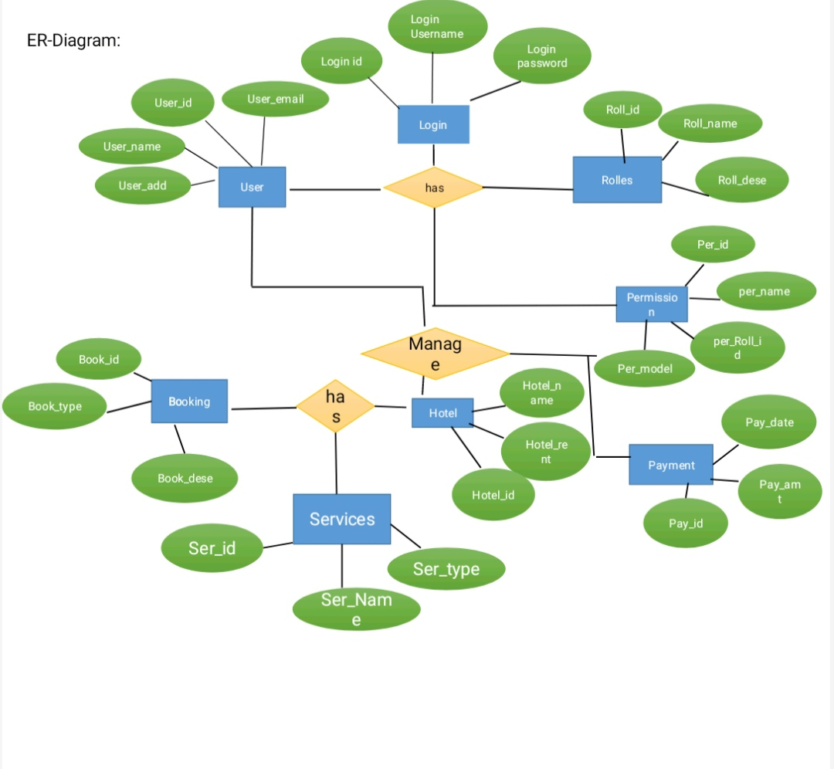

Slide 11
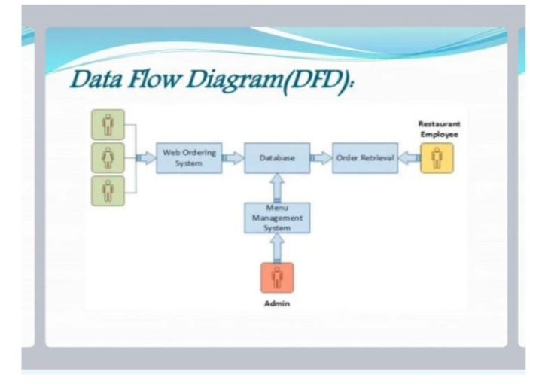

Slide 12
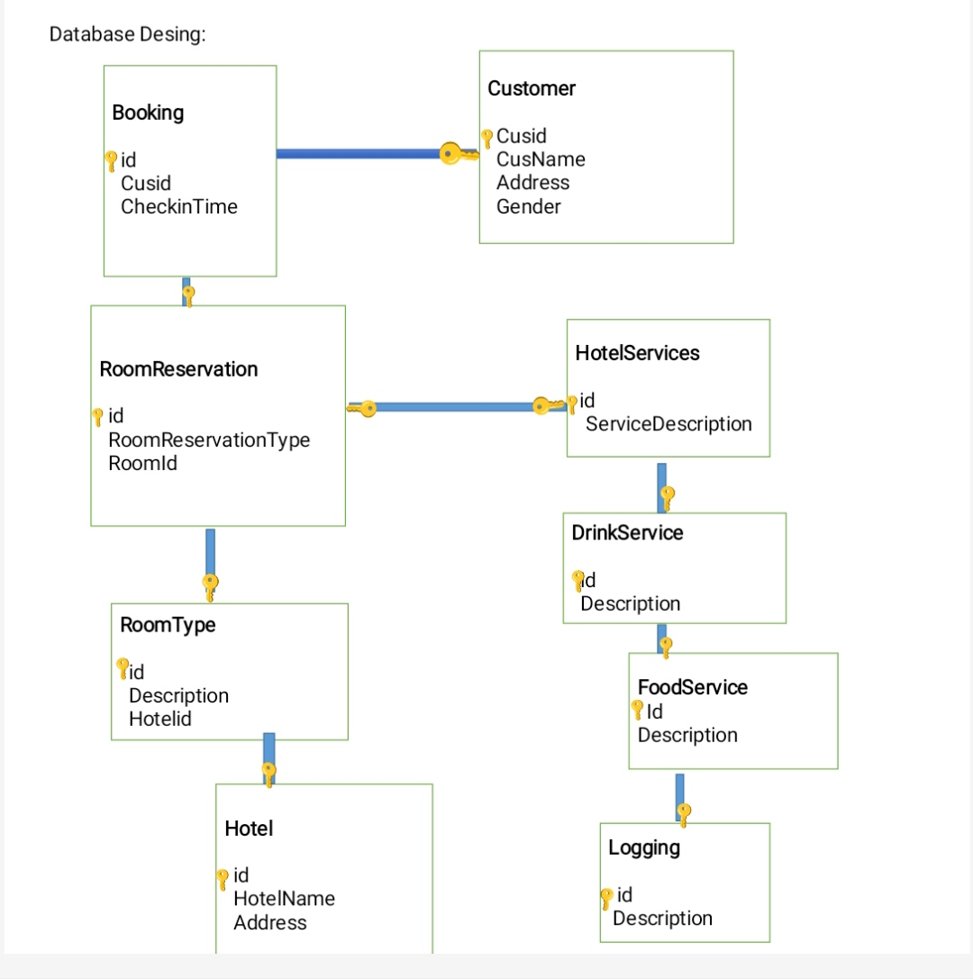

Slide 13
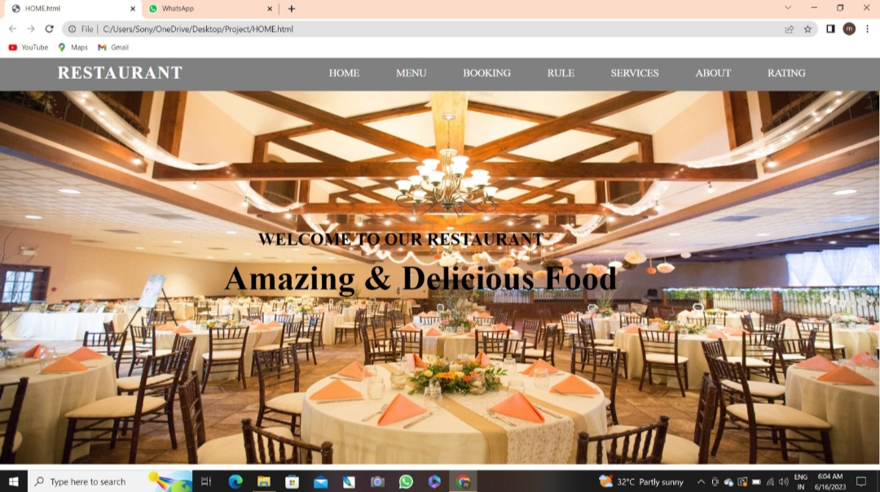

Slide 14
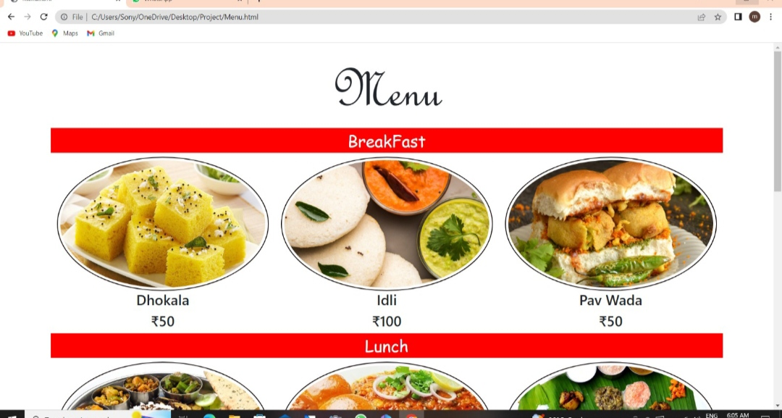

Slide 15
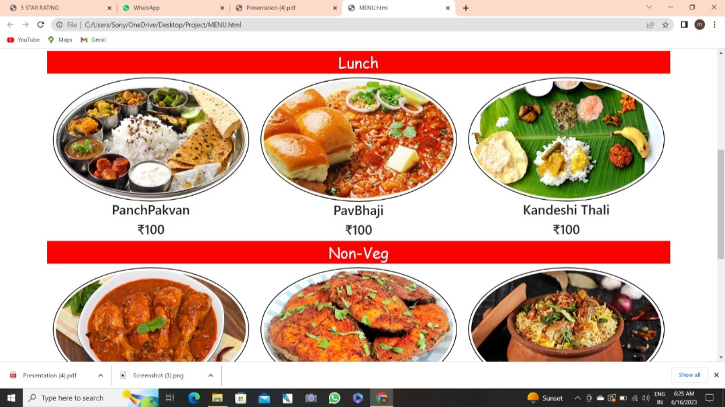

Slide 16
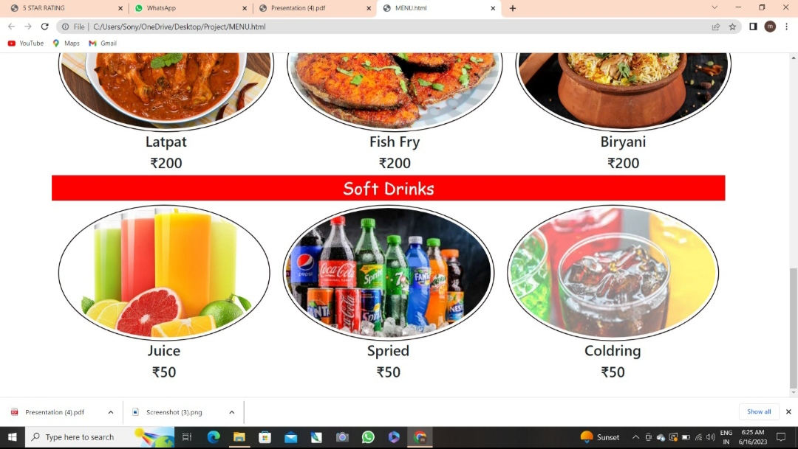

Slide 17
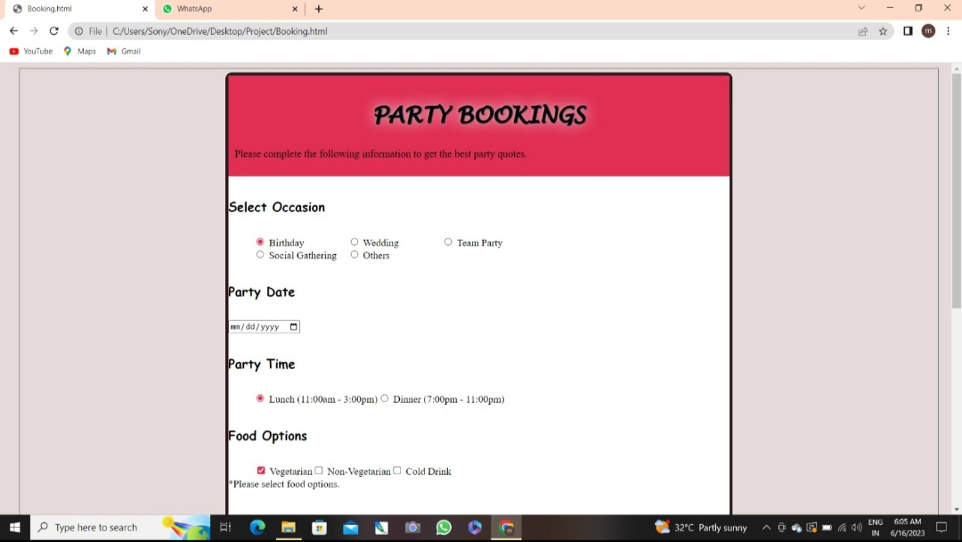

Slide 18
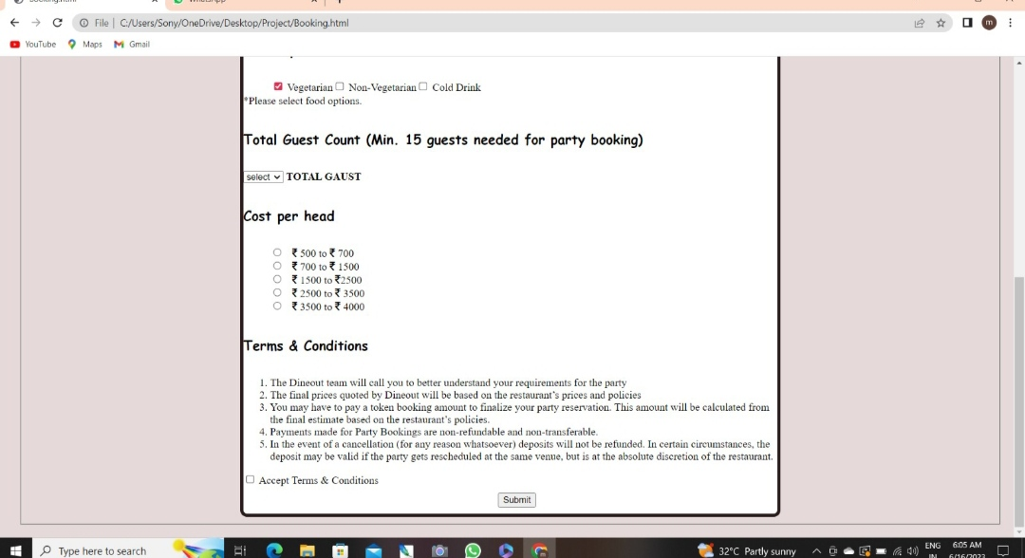

Slide 19
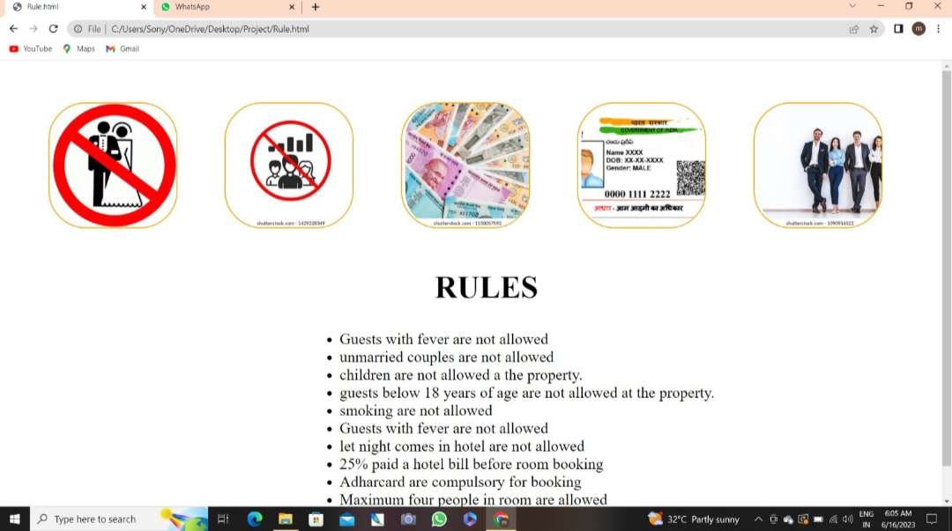

Slide 20
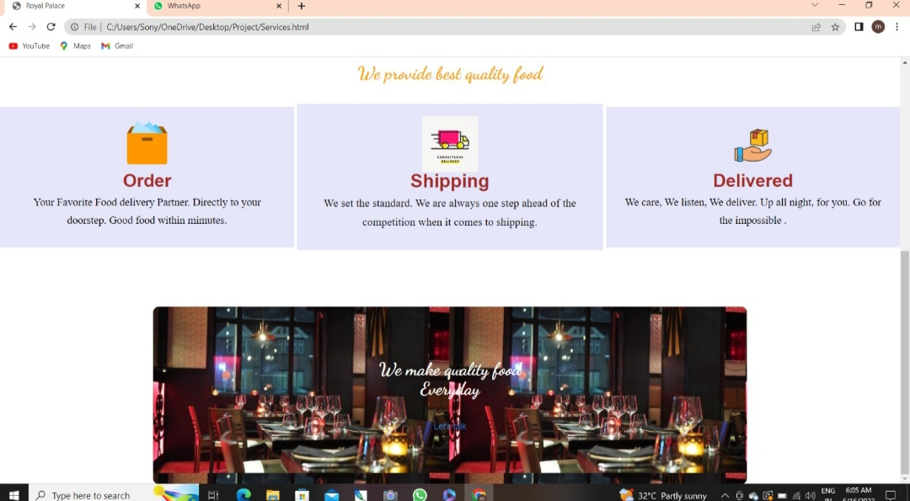

Slide 22
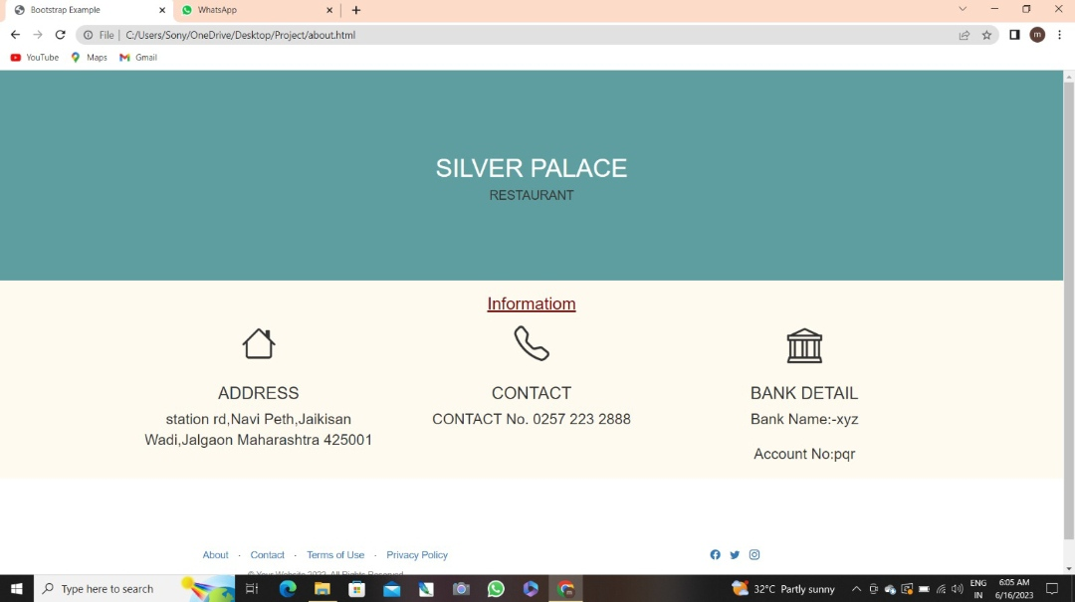

Slide 23
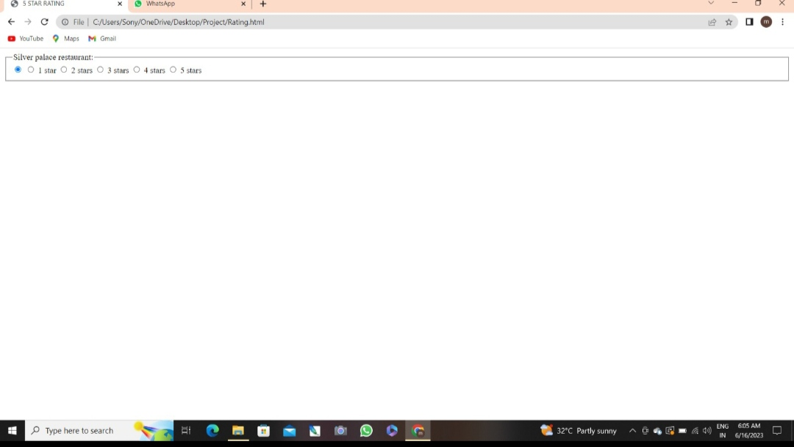

Slide 24
Conclusion
ConclusionThis is achieves through an easy to use graphical interface menu options.This users can add any number of items to the cart from any of the available food categories by simply clicking the add to Cart button for each items.Once item is added to the cart,user is presented with detailed order to review or continue shopping.

Slide 25
FEATURES SCOPE
Easy use of customer.Computerized Entry Of Details.User Friendly Interaction between User and System.Easy access to any stage.Security Provided.Lot of time is getting saved.Easy backup of data.Easy access for exotic & authentic product .

Slide 26
REFERENCE
Wikipedia
https://www.Google.com
https://www.Youtube.com
https://www.Chatgpt.com
Teacher
Friend

